Slide 1
The Algorithm Development Process
https://quantpedia.com/

Slide 2
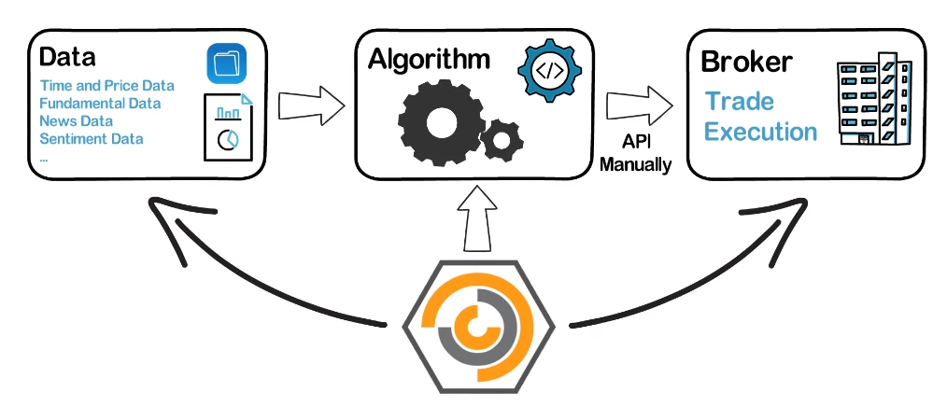

Slide 3
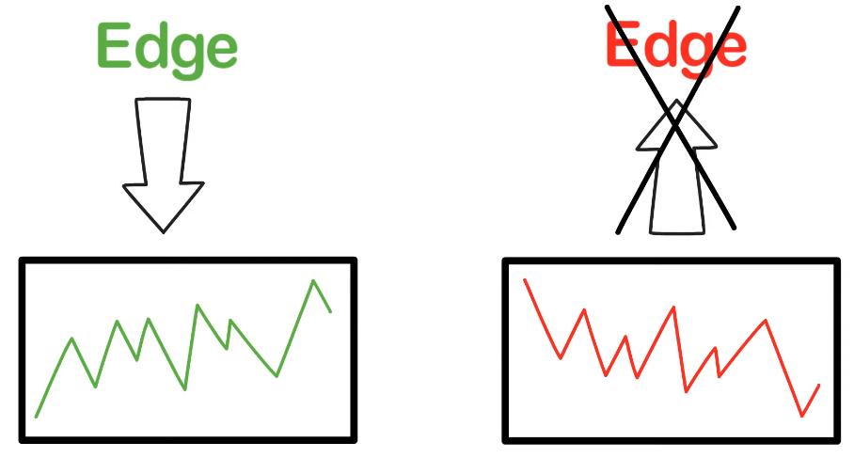
What distinguish a good trading strategy from a bad one is the edge.
The goal of an algo trade is to best possibly identify such edge, and then build strategy around the edge.
The edge comes first. You can’t just start from some random strategy and try to add in edge.
The edge is the centre piece of the strategy.

Slide 4
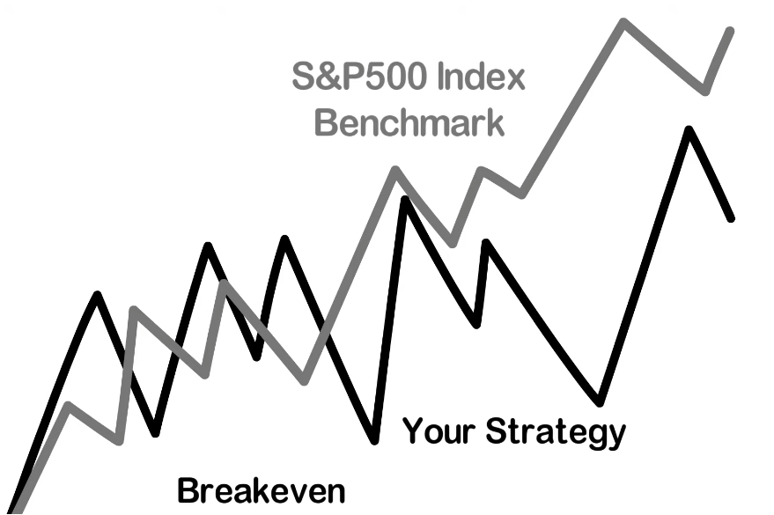

Slide 5
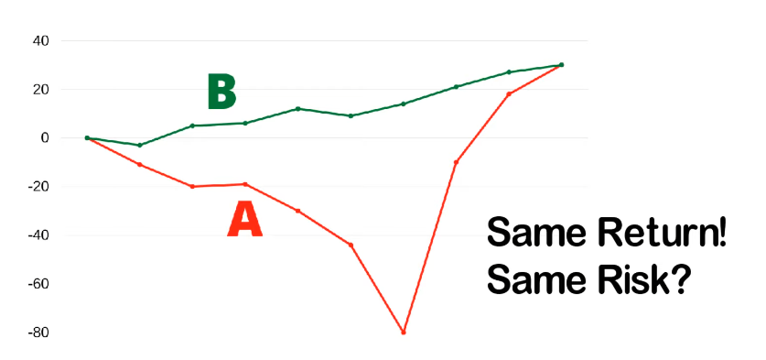

Slide 6
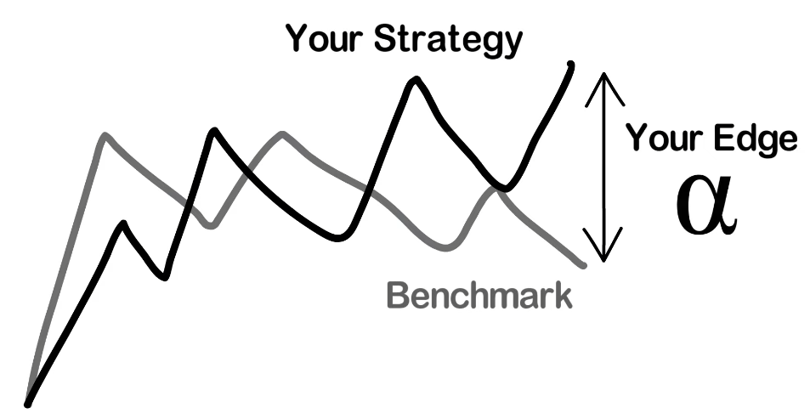

Slide 7
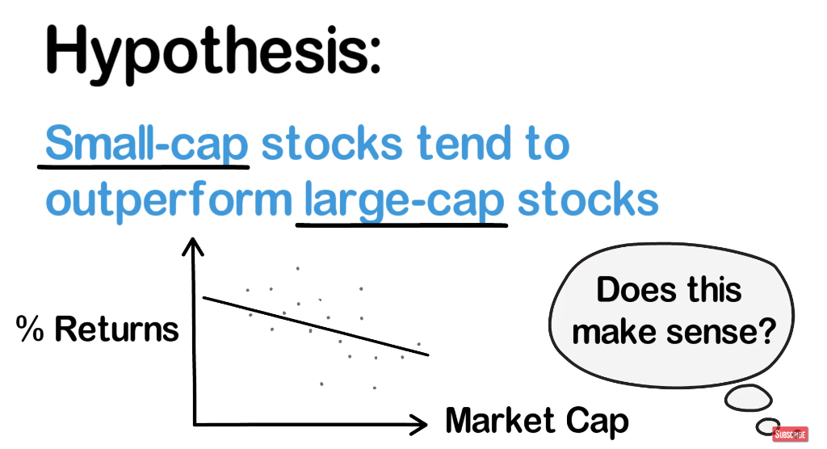

Slide 8
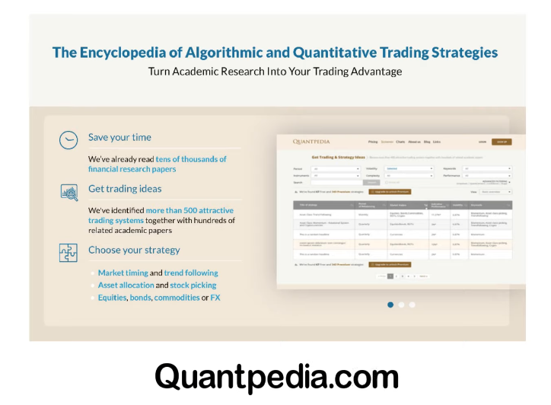

Slide 9
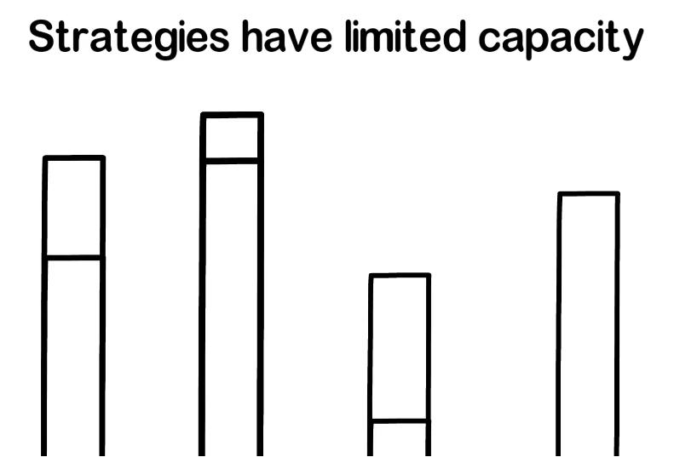

Slide 10


Slide 11
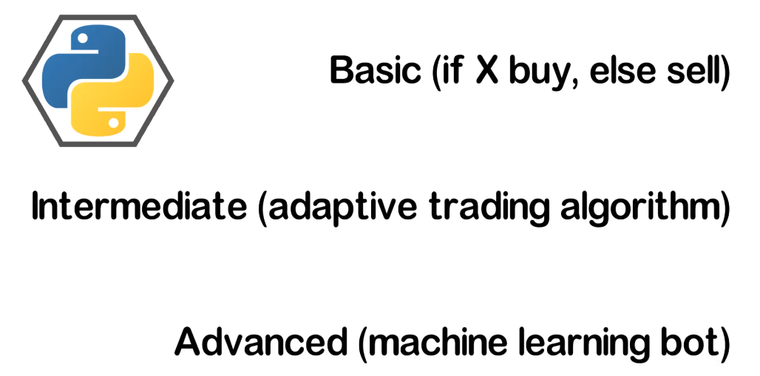

Slide 12
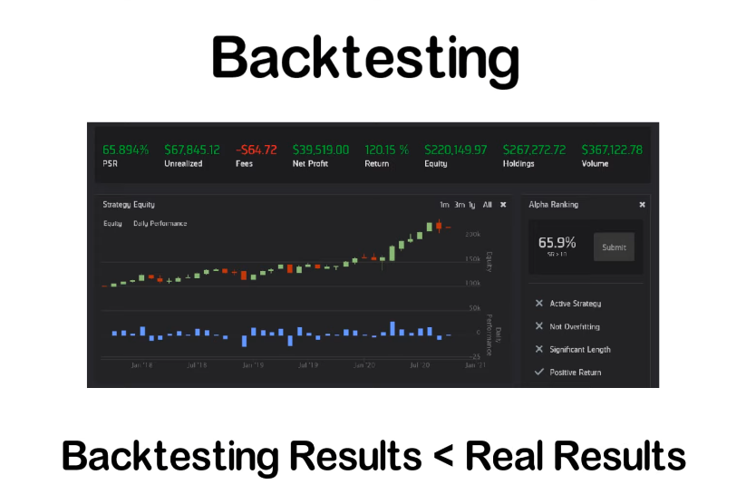

Slide 13
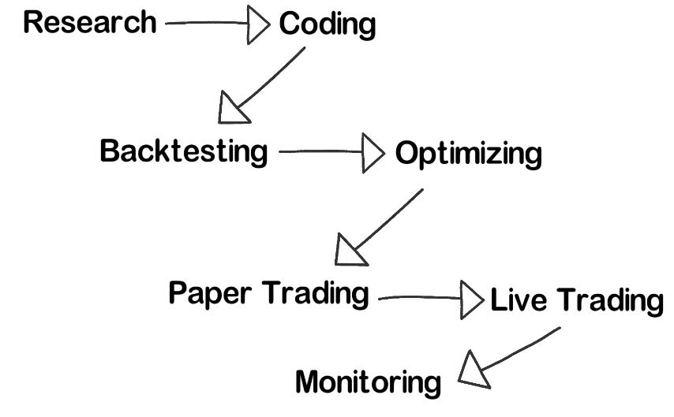
The most important part is research and finding an edge

Slide 14
